Slide 1
Which Neighborhood in Atlanta is Best for a Metal Music Venue Business? Considering Transportation, Demographic, and Urban Planning Factors
Tingyu Liu

Slide 2
Index
3 Topic and Objectives
4 Method & Tools
5 Data Used
6 Competitor Analysis
7 Transport Analysis
8-9 Demographic Analysis
10-11 Factor Integration
12-13 Restriction Analysis
14 Conclusion and Discussion
15 Reference

Slide 3
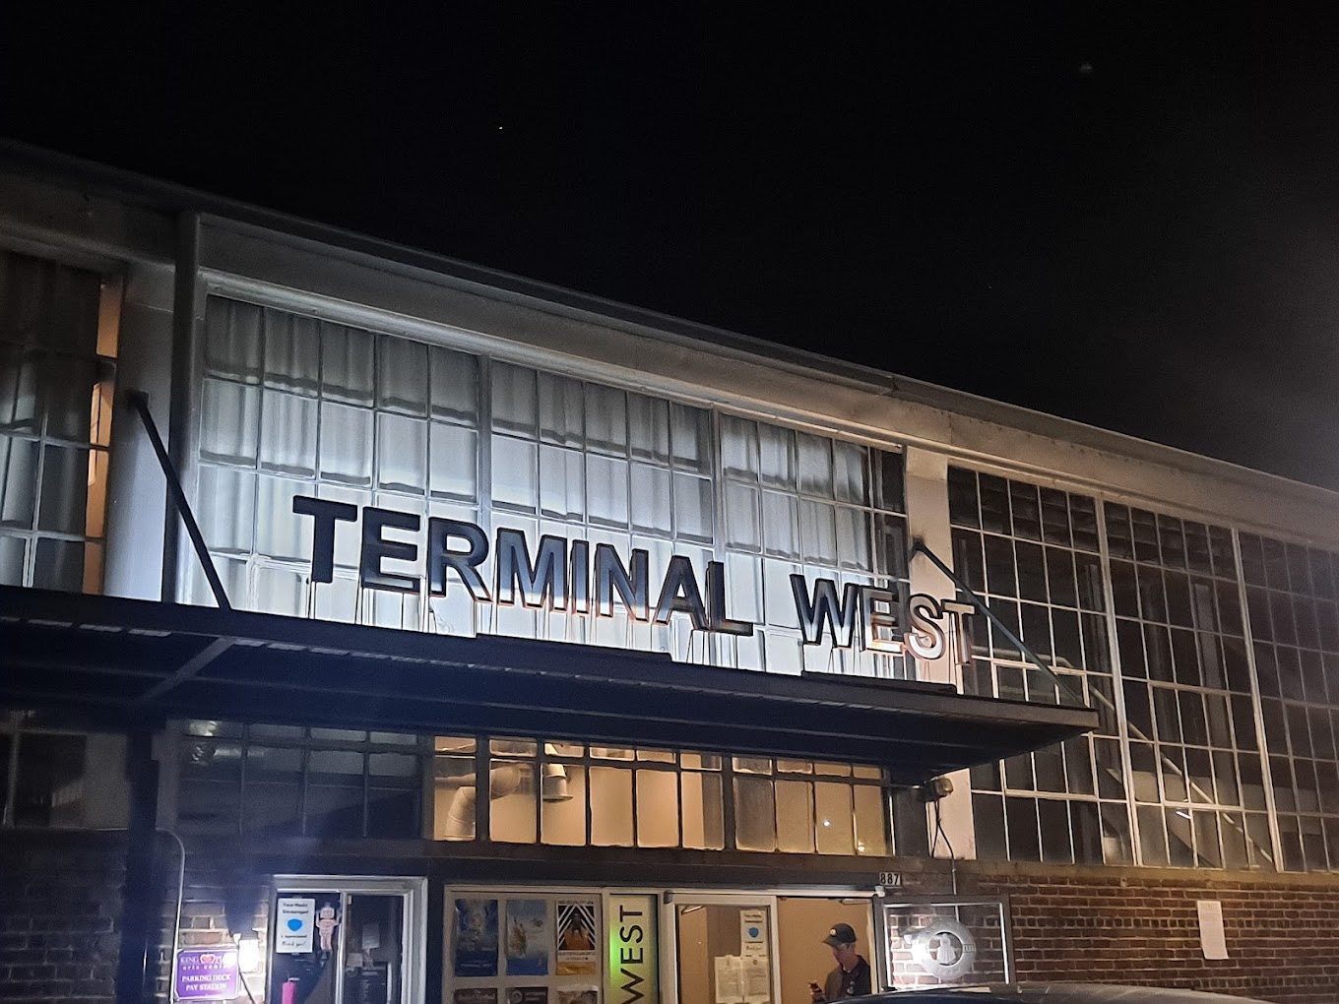
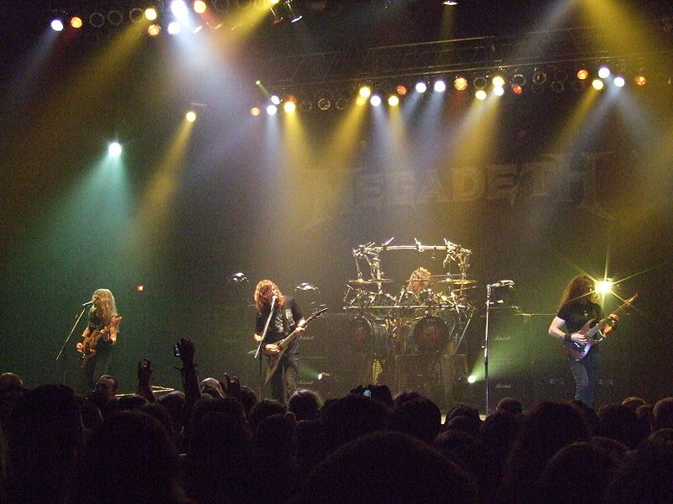
Topic and Objectives
Evaluate the accessibility to current music venues.
Identify neighborhoods with high potential for establishing metal music venues, considering transport, demographic, and urban planning factors.
Contribute to promotion of a vibrant music scene in Atlanta.
Transport & GIS:
Network Analysis
Vector Analysis
Business:
Cost Analysis
Competitor analysis
Location analysis
Sociology:
Sub-cultural group(metal music) Analysis
Urban planning:
Zoning
Landuse
Terminal West, a music venue near Georgia Tech
A metal music live

Slide 4
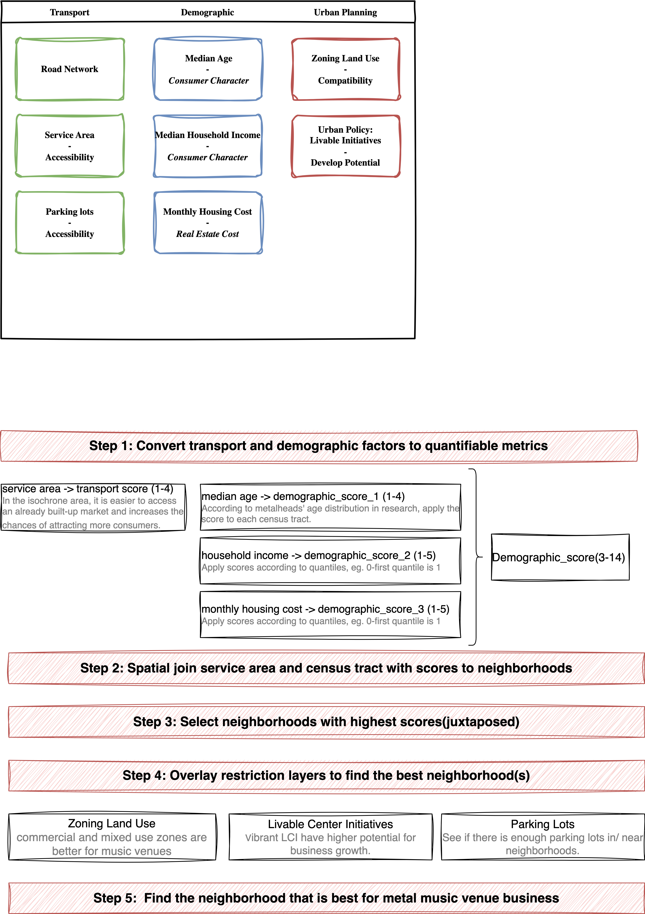





Method & Tools
ArcGIS Pro: Service Area
QGIS: Join attribute by location, Field Calculator, Attribute Table Edit, Layouts
Python:
OSMnx: Network analysis and Data collection
Folium: Interactive visualization
Geopandas: Geospatial data processing
Spatial and mathematical model
Tools used

Slide 5
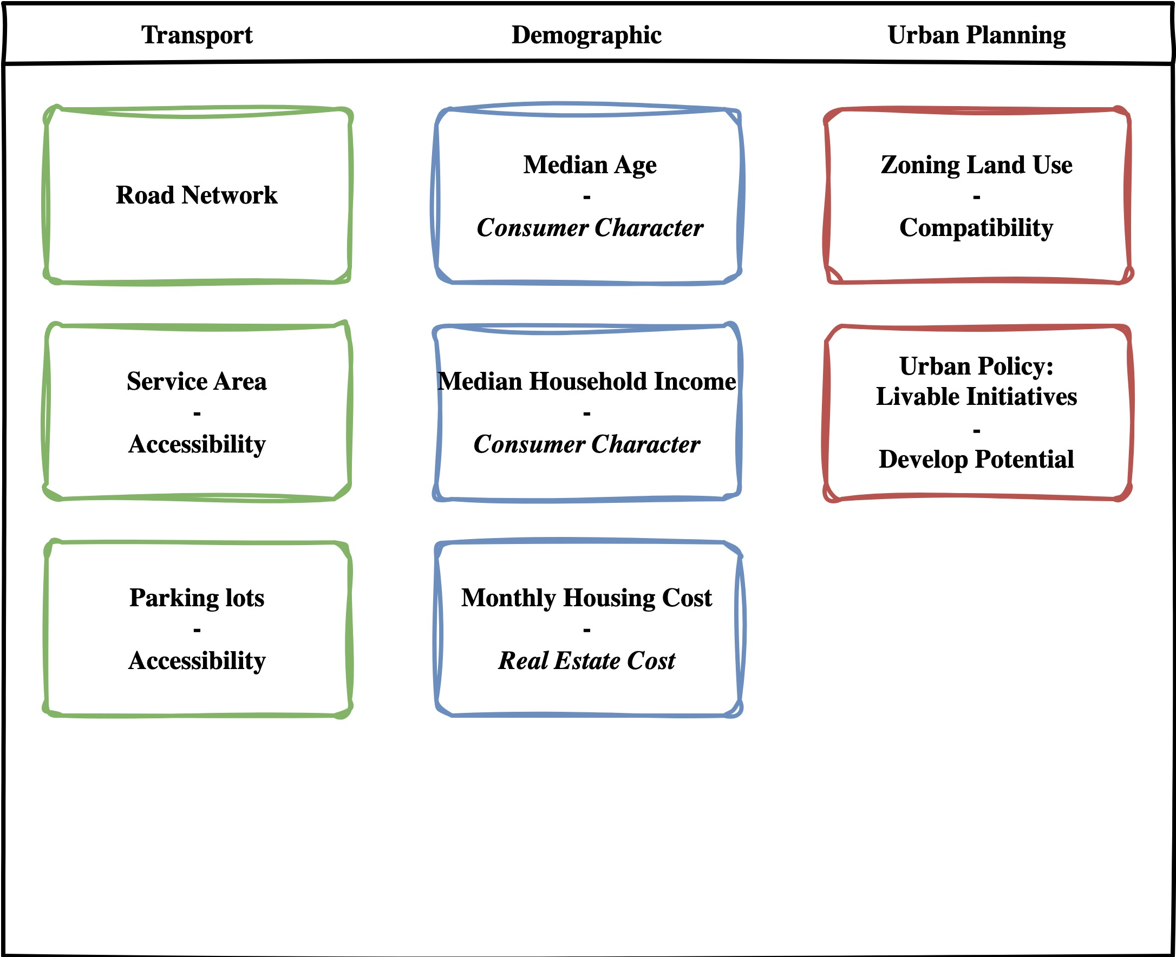



Data
Census tract with housing price, household income, age, race – Census Bureau API
Music venue POI - Yelp API
Parking lot, Road network - OSMX download
Atlanta Neighborhood Area - Course Material
Notes:
Add icons!!!

Slide 6
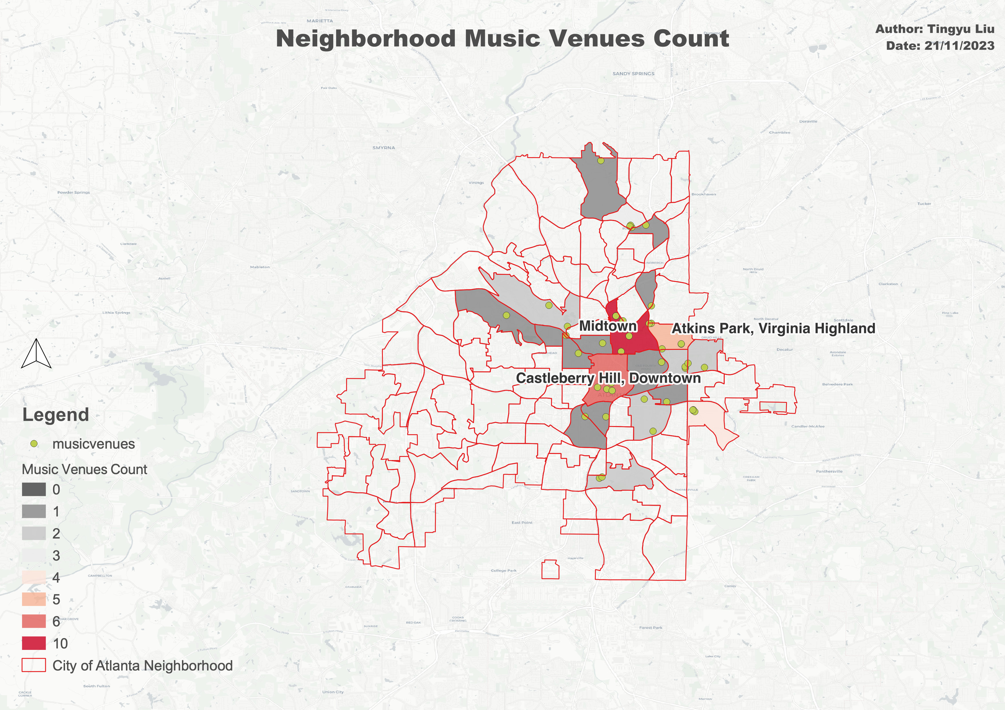
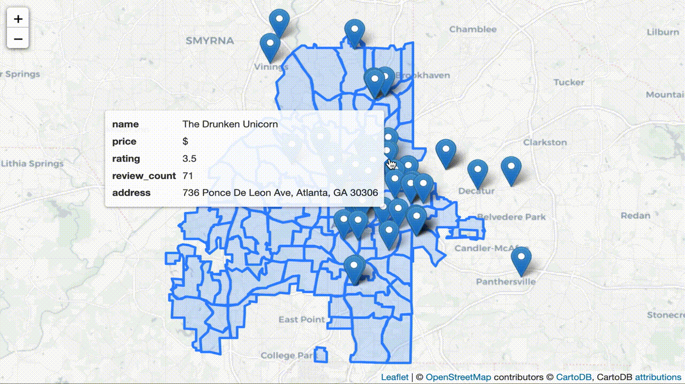

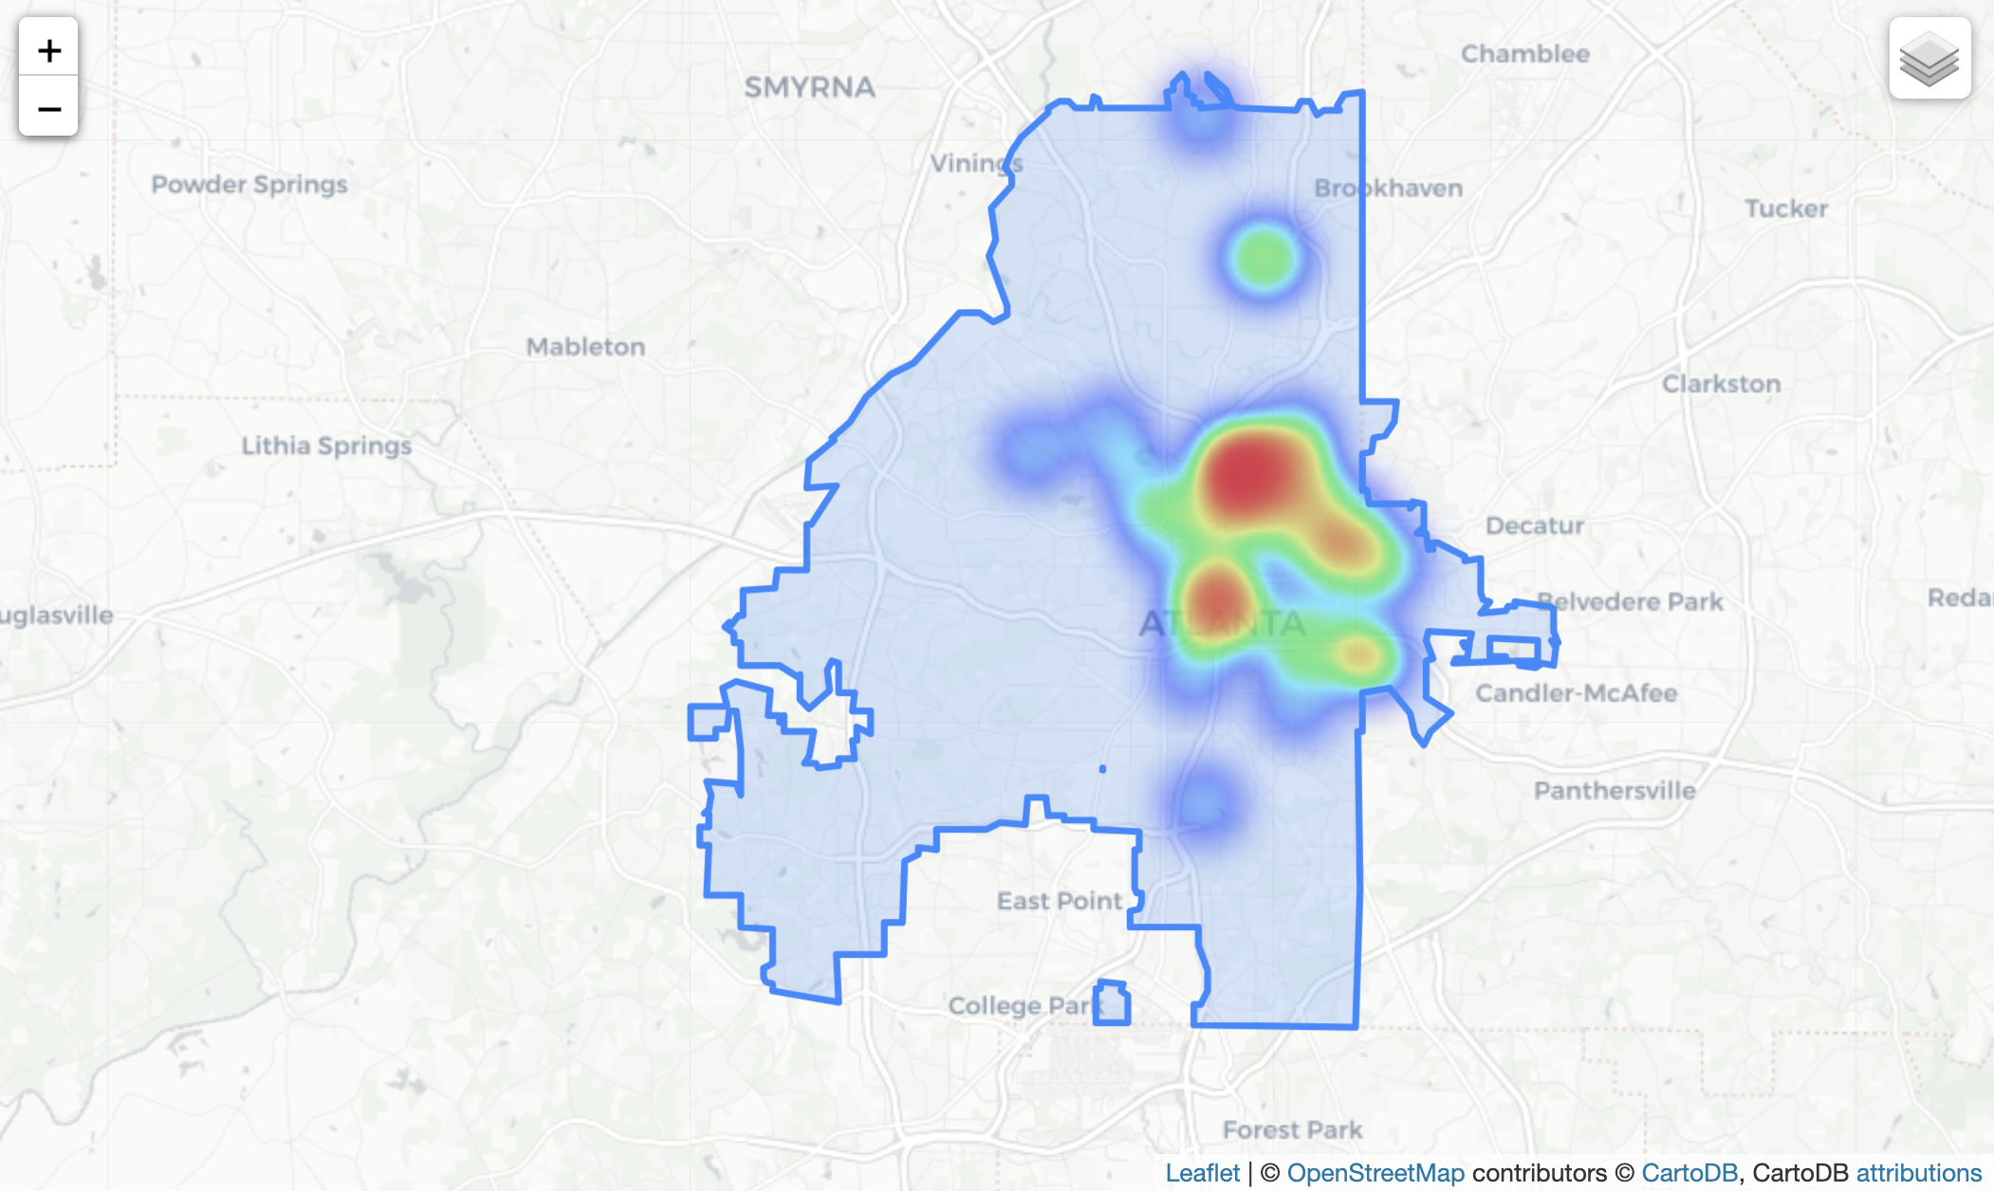
Competitor Analysis: Existing Music Venue
Main text – Navy Roboto 24px.
Example of a sub point. 18px Roboto
Subpoint example
Sub-sub point example the first
And the second
Music Venue Attribute
Spatial Distribution of Existing Music Venue
Music Venue Density

Slide 7
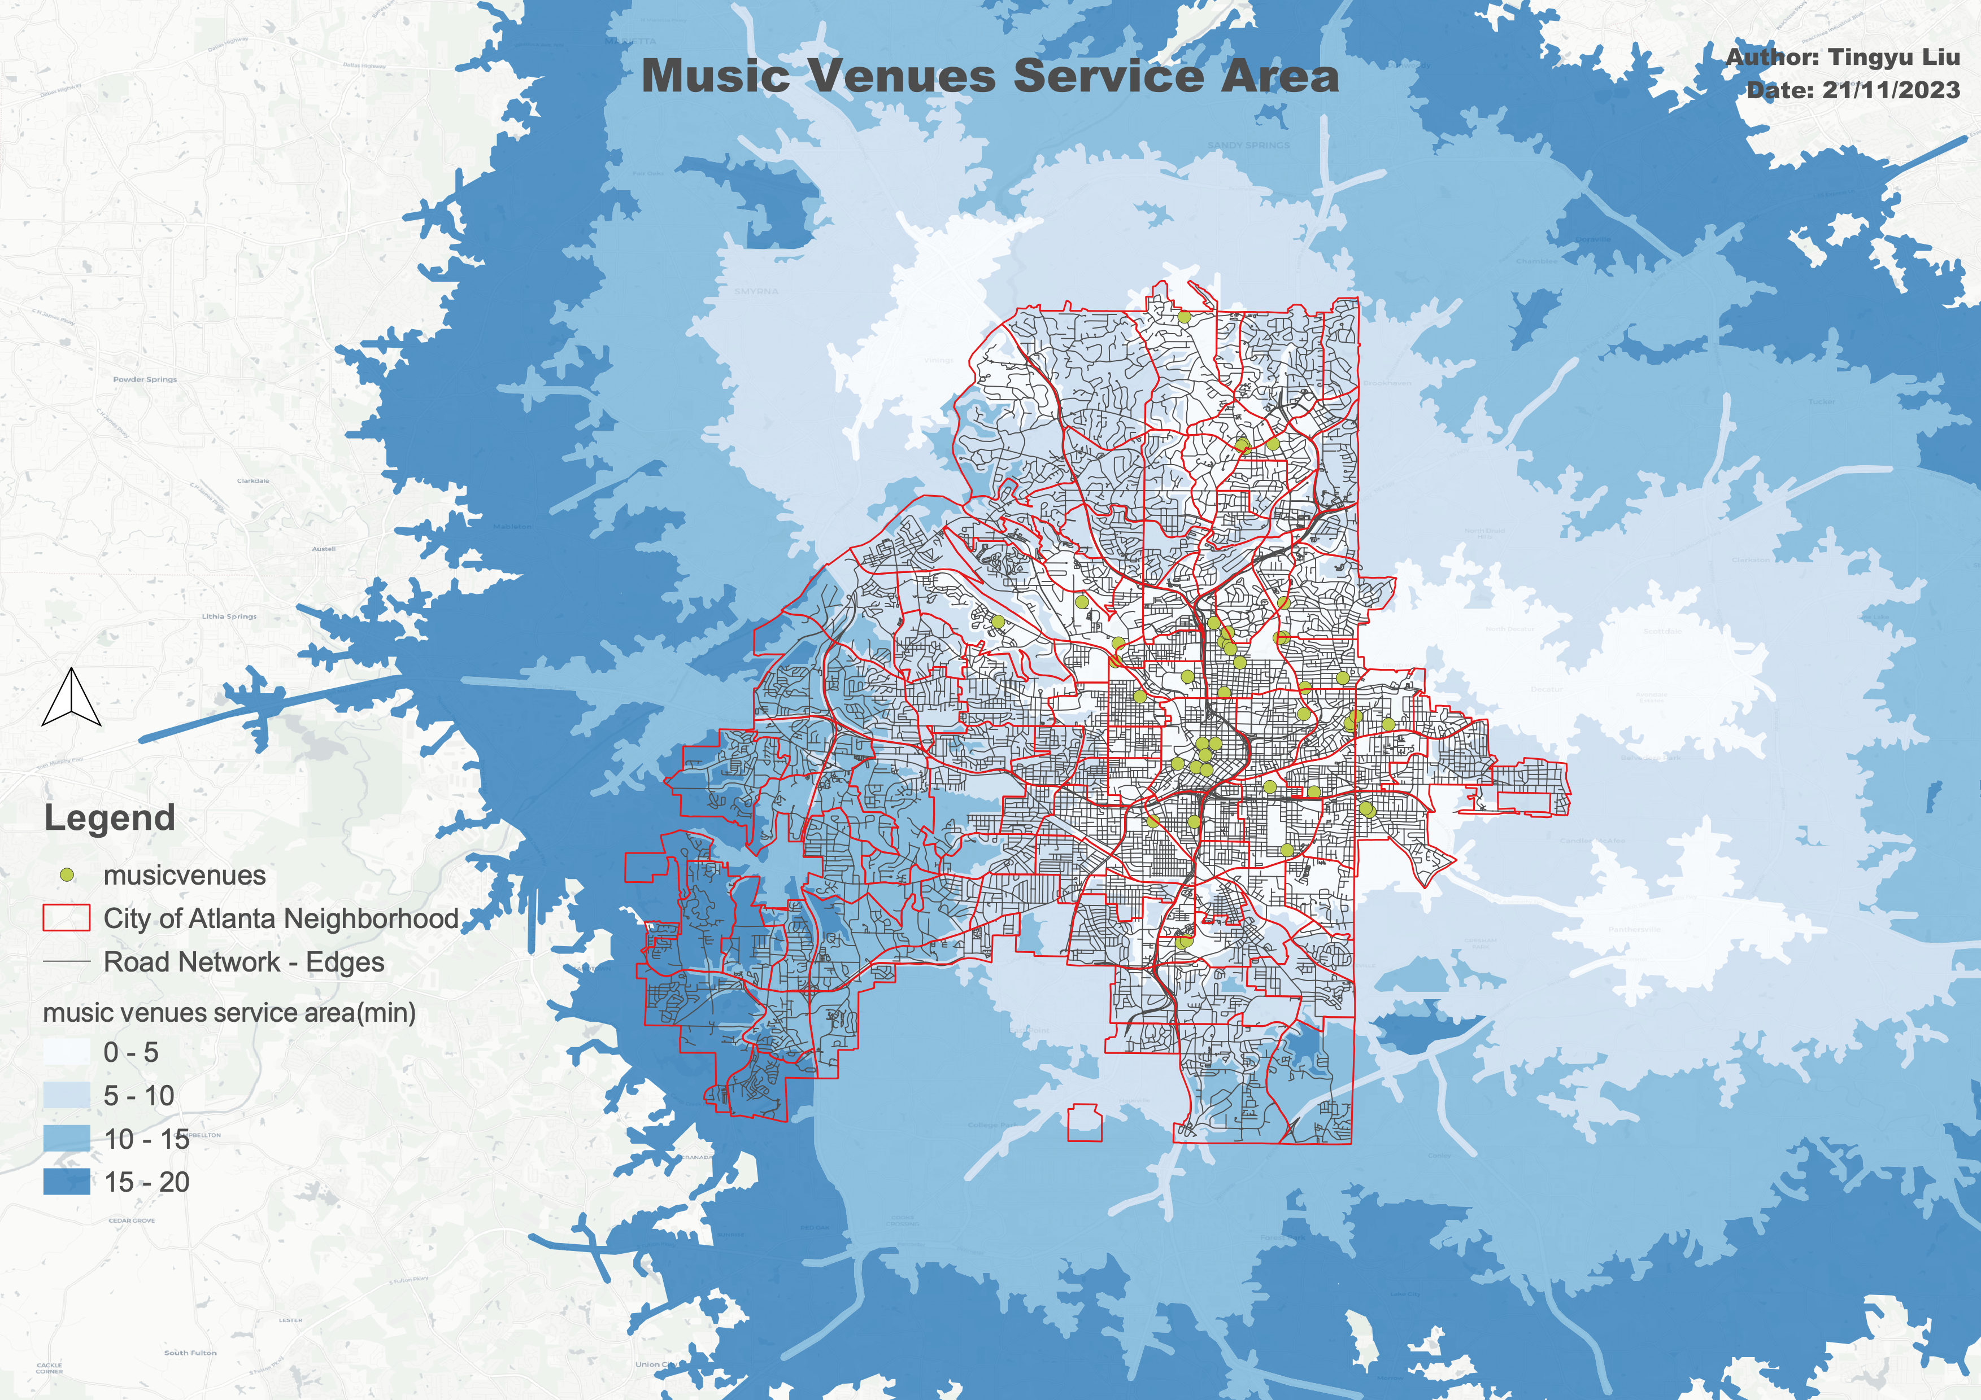
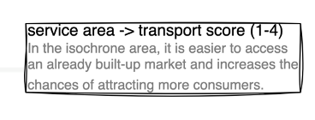
Transport Analysis: Existing Music Venue Service Area
Main text – Navy Roboto 24px.
Example of a sub point. 18px Roboto
Subpoint example
Sub-sub point example the first
And the second
Facilities: music venue point of interest
Network: road network
Time threshold: 5, 10,15, 20
Type: Driving

Slide 8
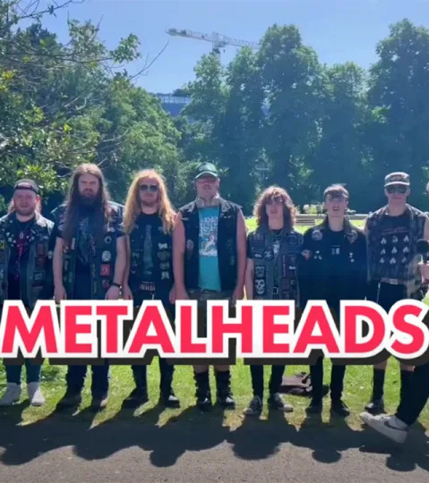
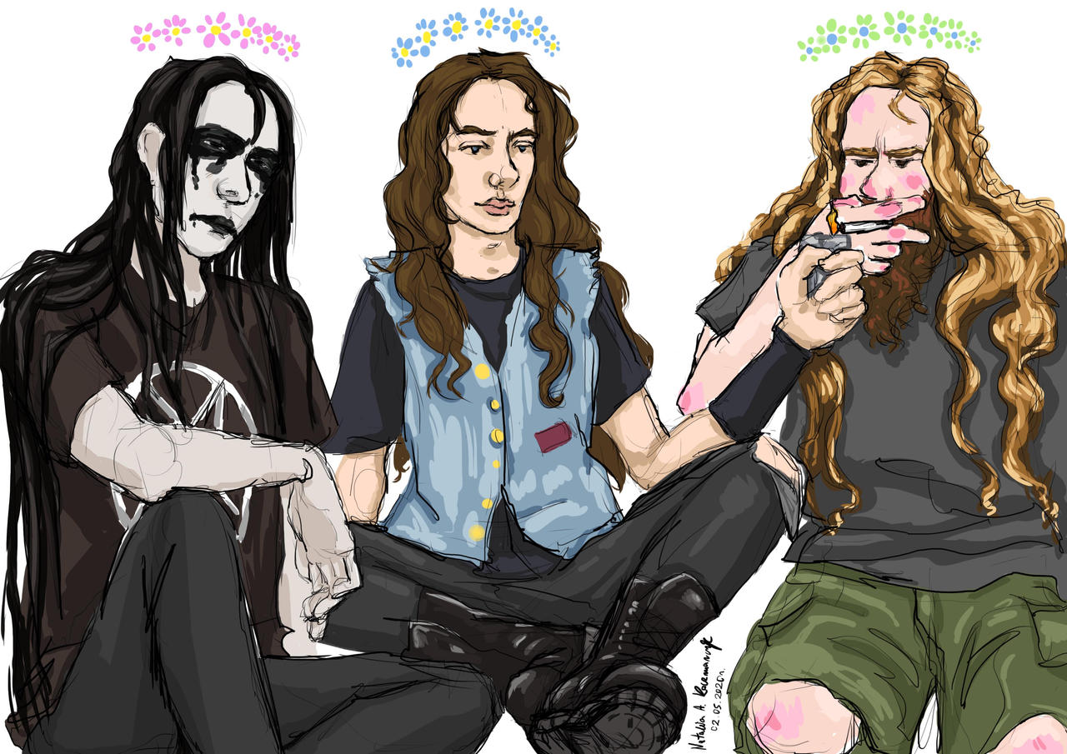
Demographic Analysis – Who are metalheads?
Metalheads are people who enjoy metal music and regularly attend metal music venues = consumers
- Largely white, cis-gendered, and male.
- Age: Majority age range is 18-34
- Most popular in North America and Northern Europe.
Metalheads’ age distribution,
Shown in research(Shukla,2022)
Typical/ stereotypical metalheads
Notes:
The presentation should include your project objectives, the spatial or mathematical model that you built, analysis results, and findings. This will account for 15% of your final grade.

Slide 9
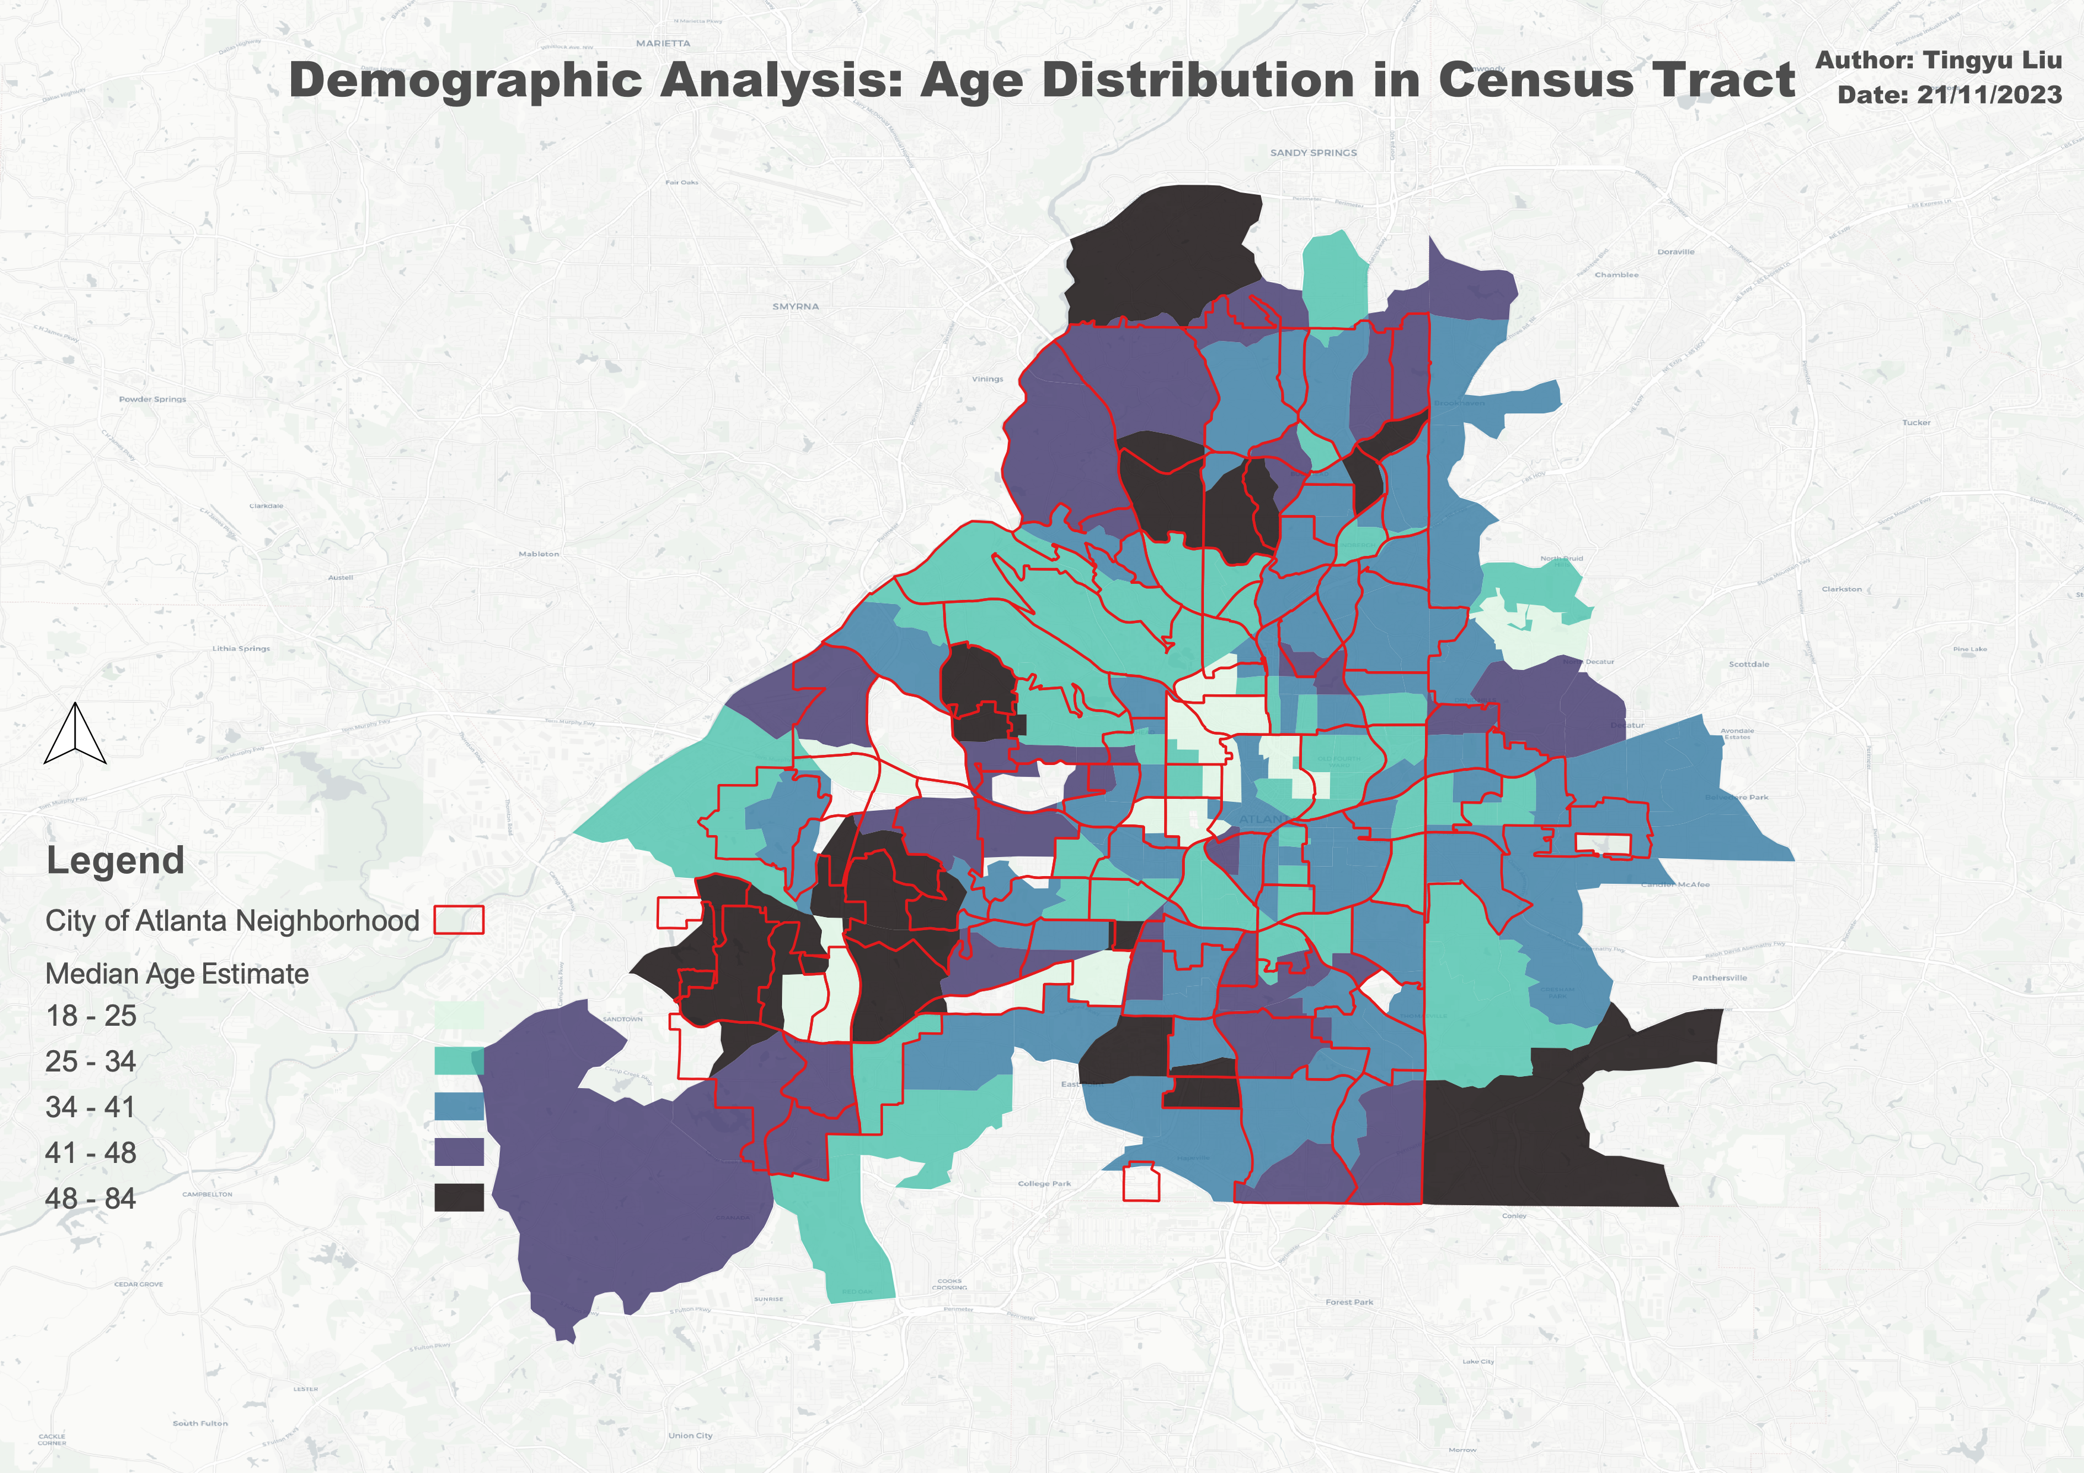
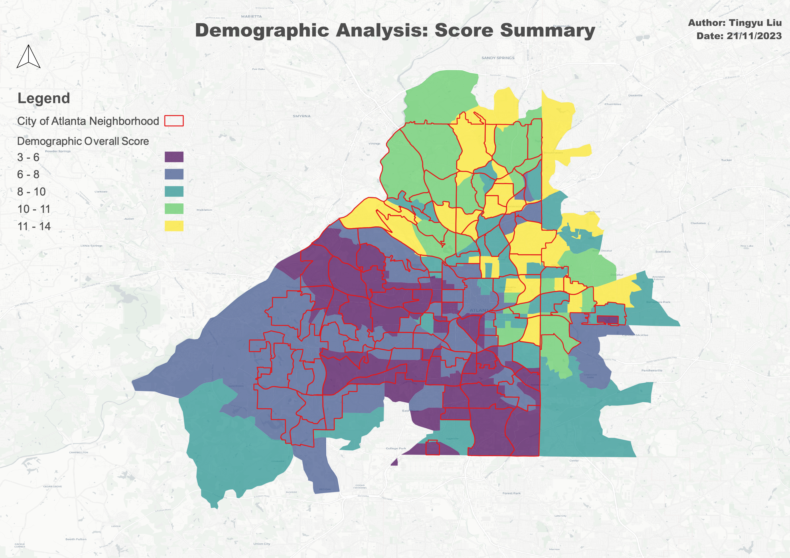
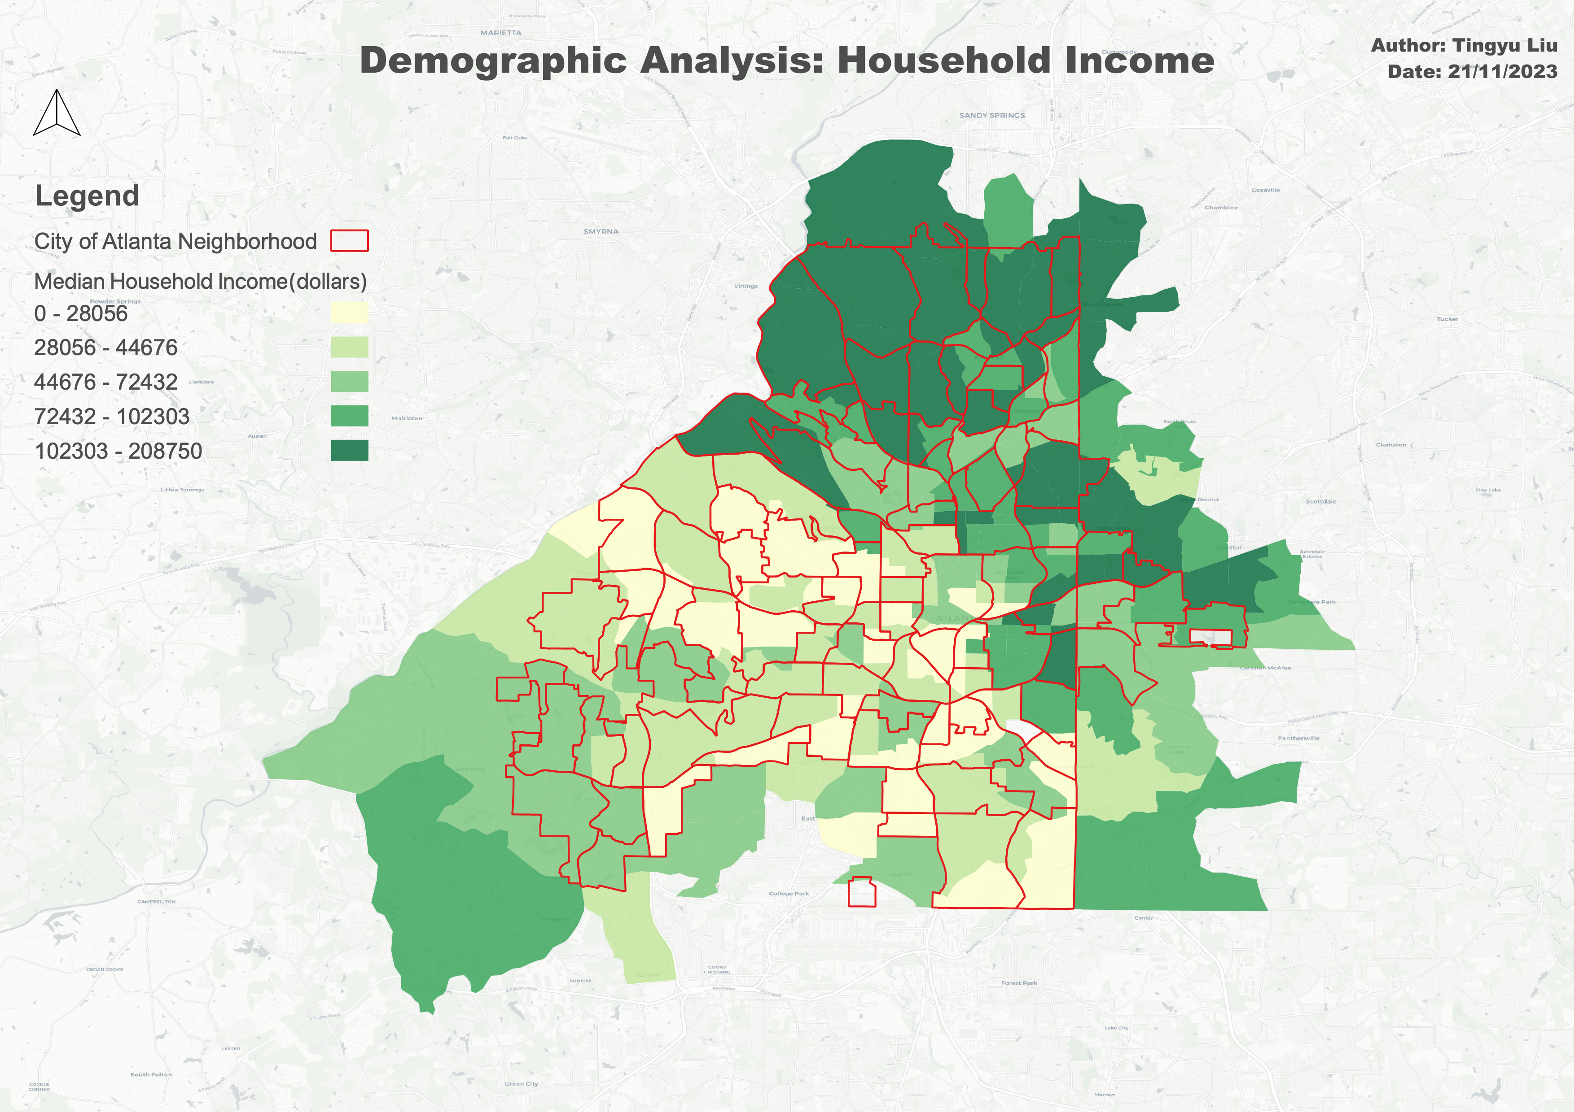
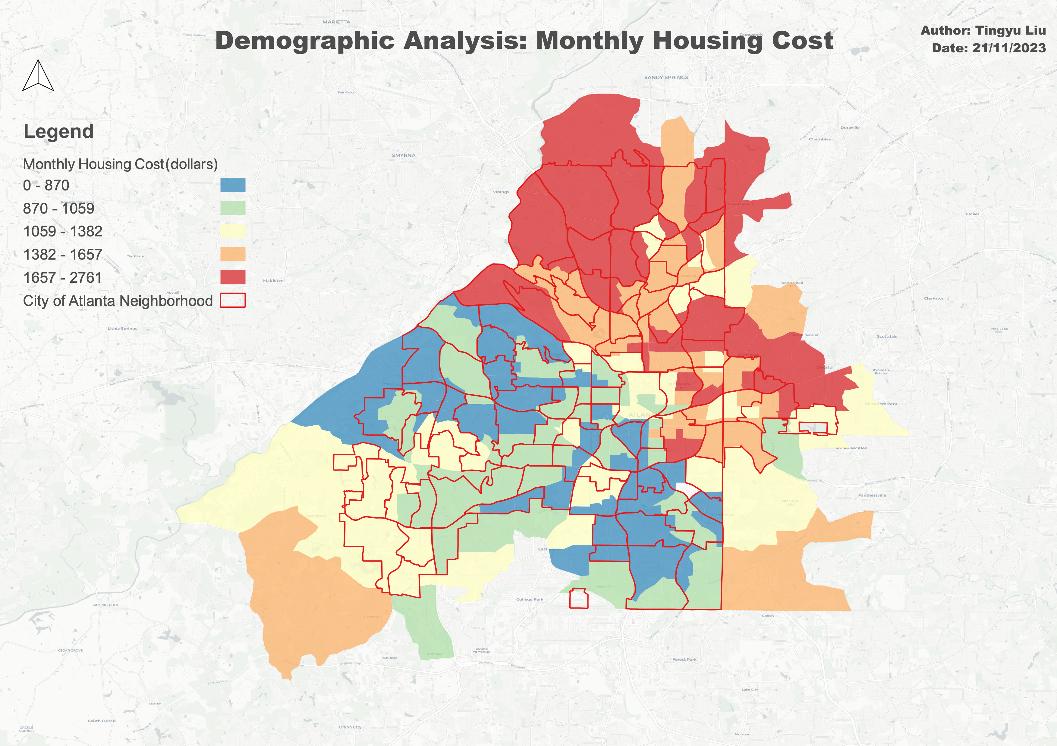
Demographic Analysis – Census Tract

Slide 10
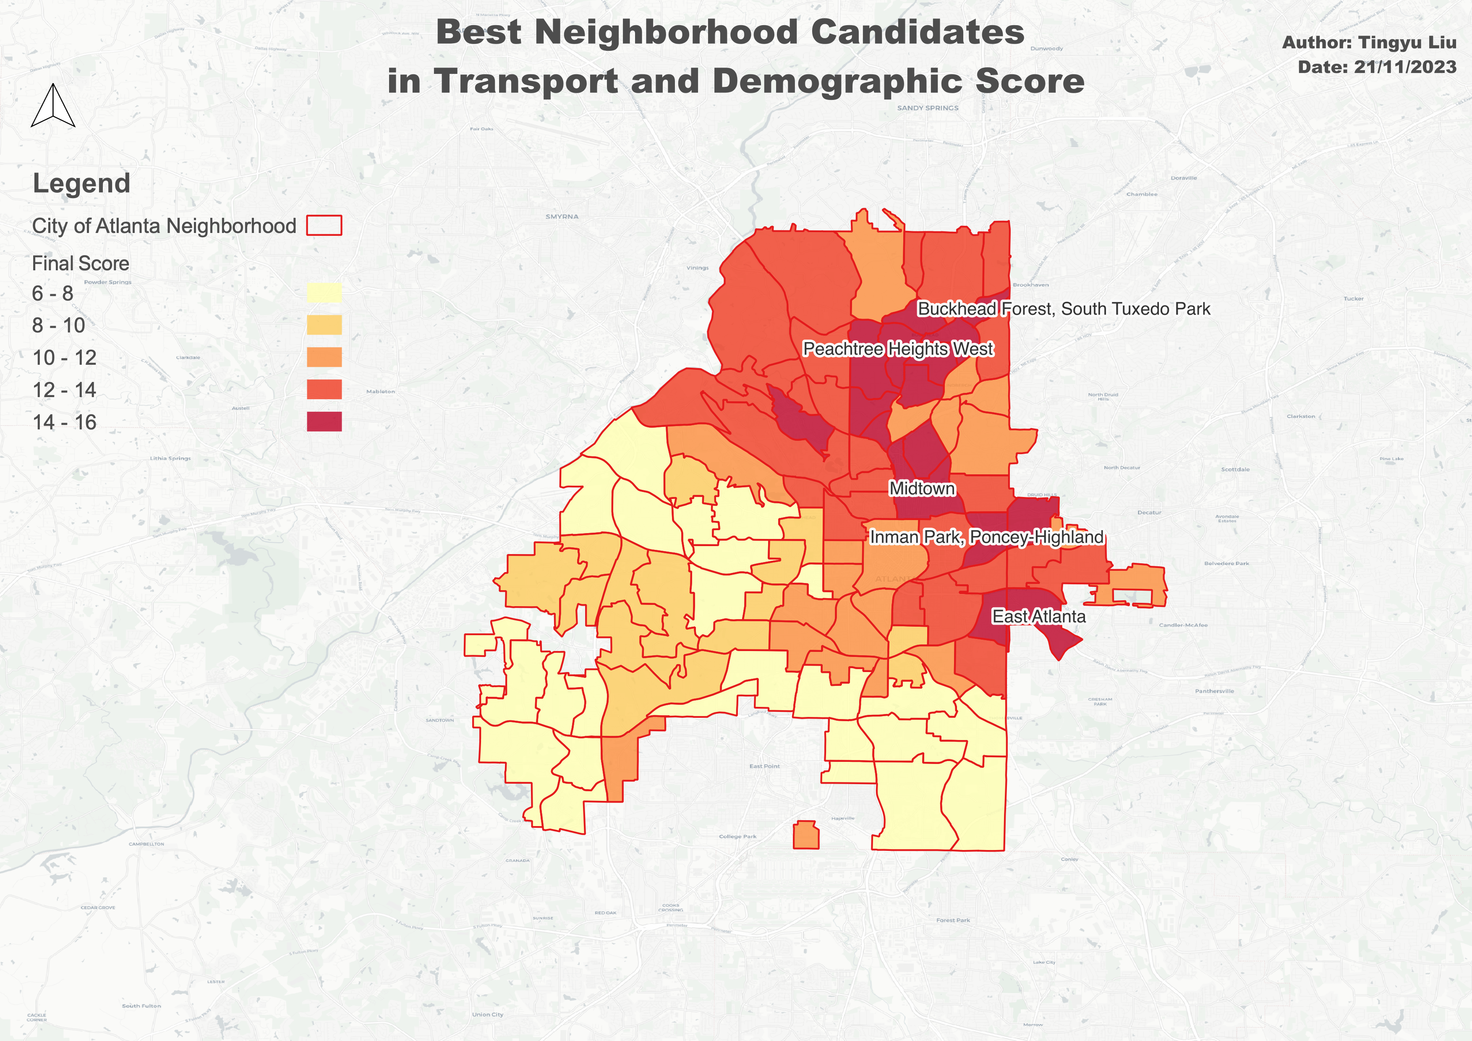
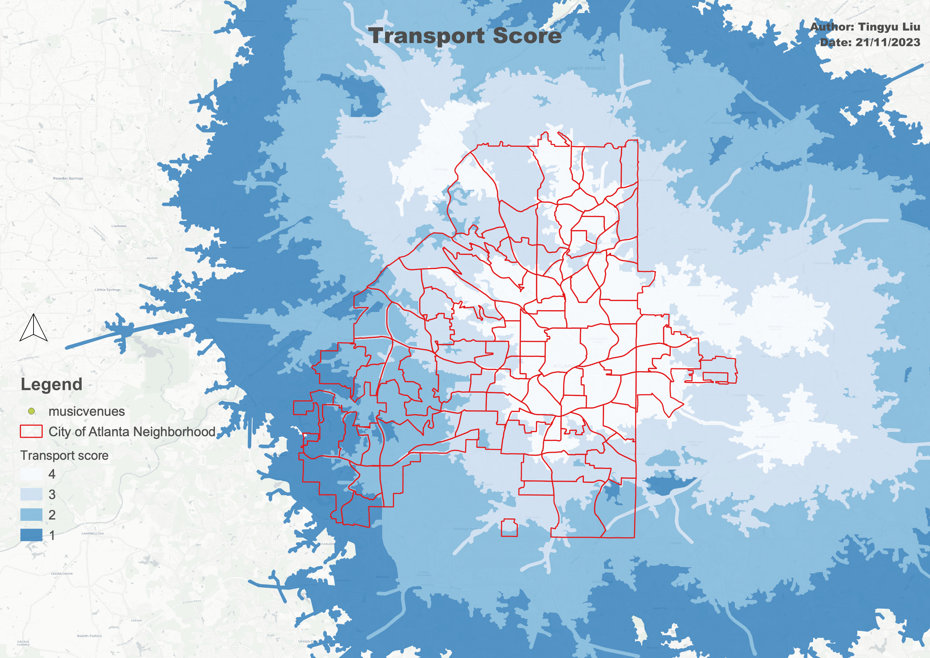
Factor Integration
Join attribute(score) by location
to each
Neighborhoods
Weighted by area

Slide 11
Integrate Transport and Demographic Factors
After adding up the transport and demographic scores, the neighborhoods with the highest score (15/16) are:
Midtown
Inman Park
East Atlanta
Peachtree Heights West
Buckhead Forest

Slide 12
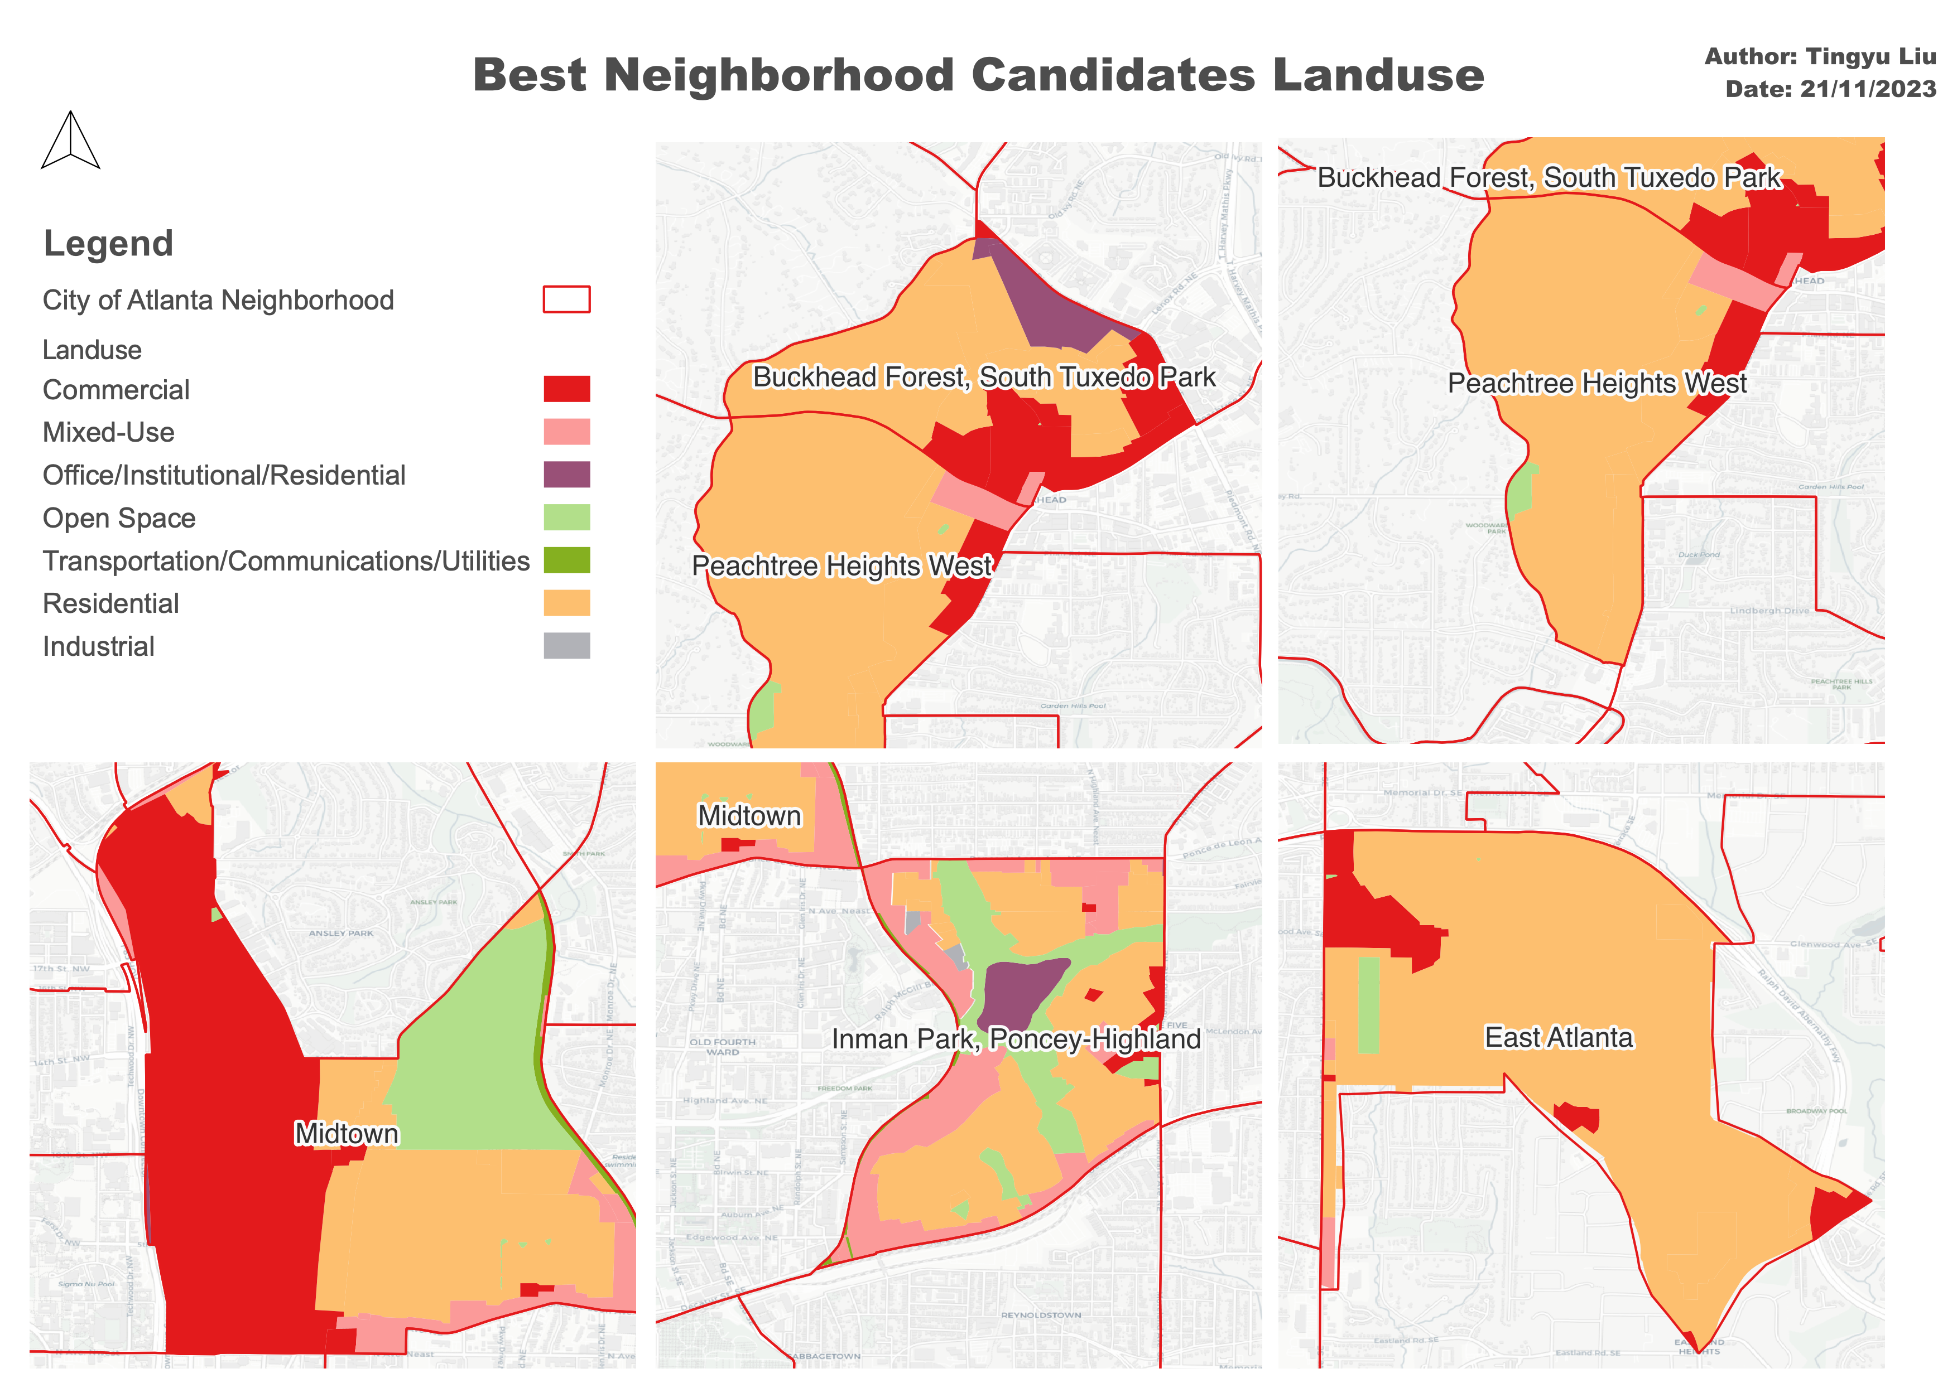
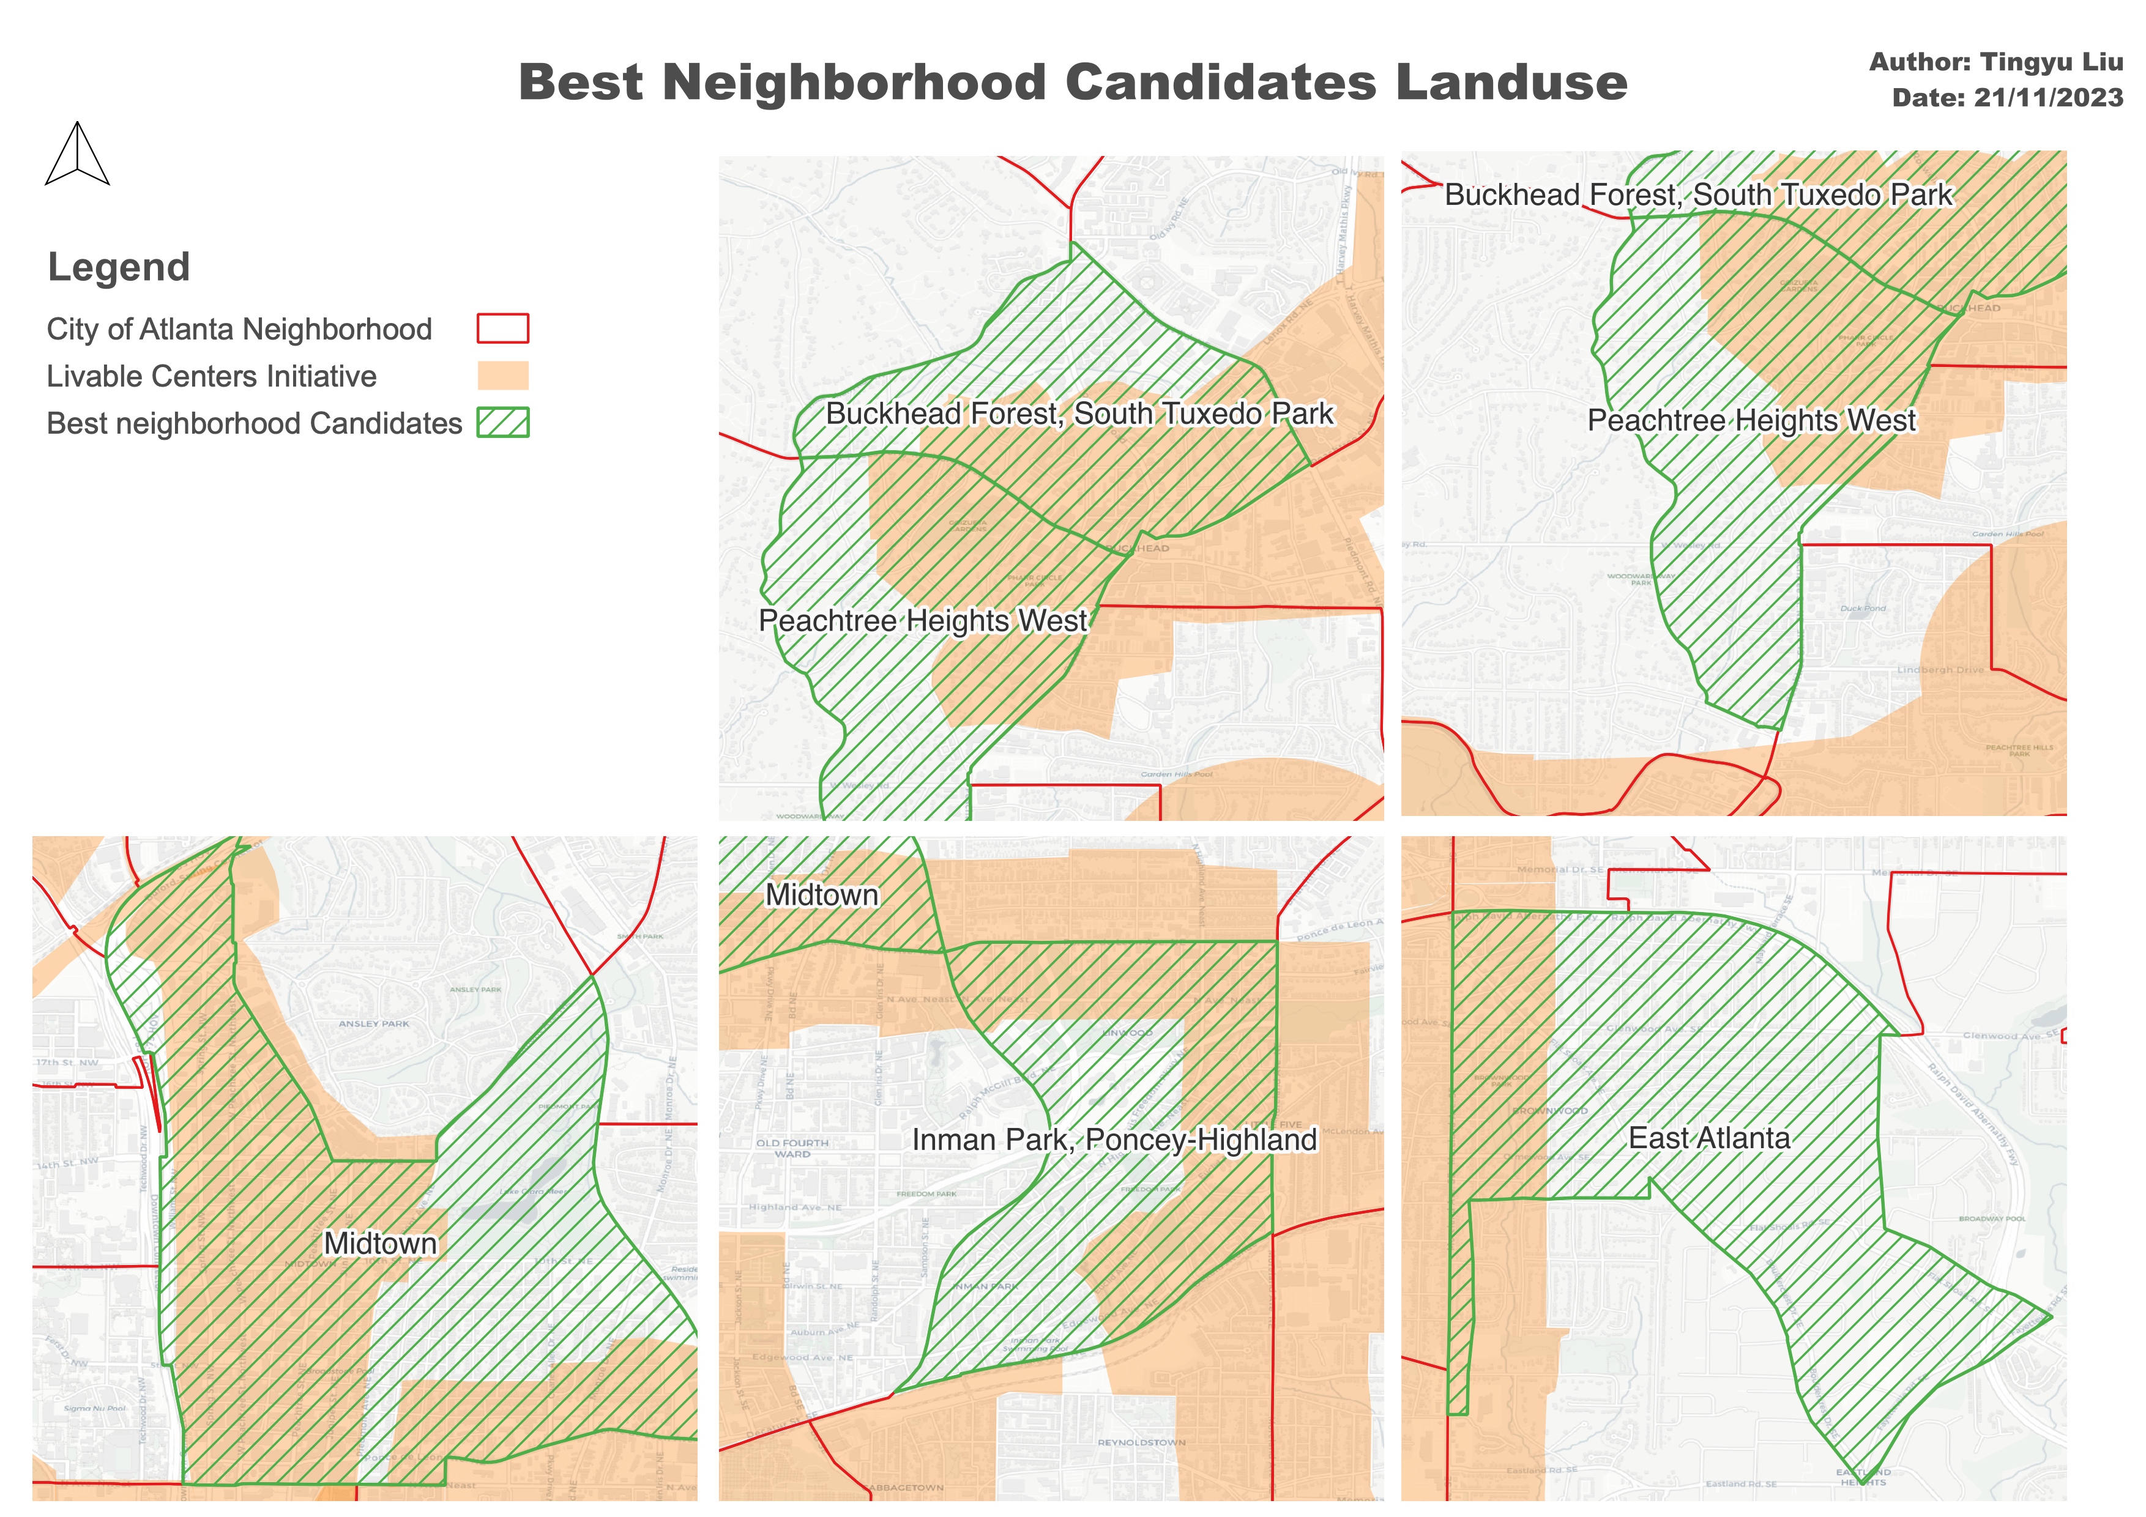
Restrictions: Zoning
The Midtown, Inman Park, and Buckhead Forest neighborhoods perform better in terms of zoning restrictions.
Contextual Information: Commercial and mixed-use land use are more suitable for a music venue business. The Livable Centers Initiative encourages vibrant and walkable places.

Slide 13
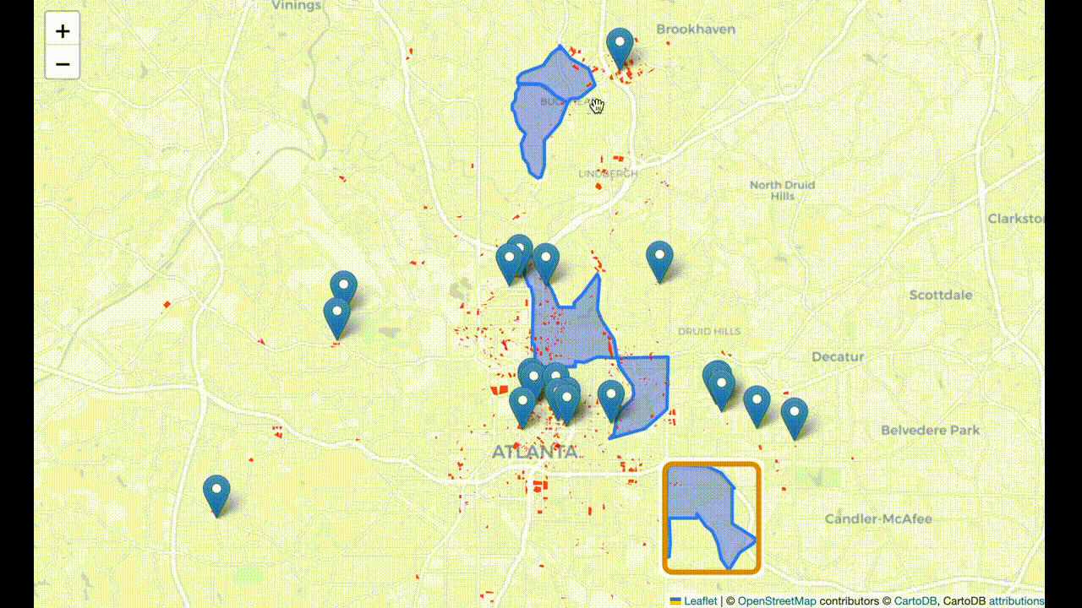
Restrictions: Parking
Based on parking lot amenity, Midtown and Inman Park are the best!

Slide 14

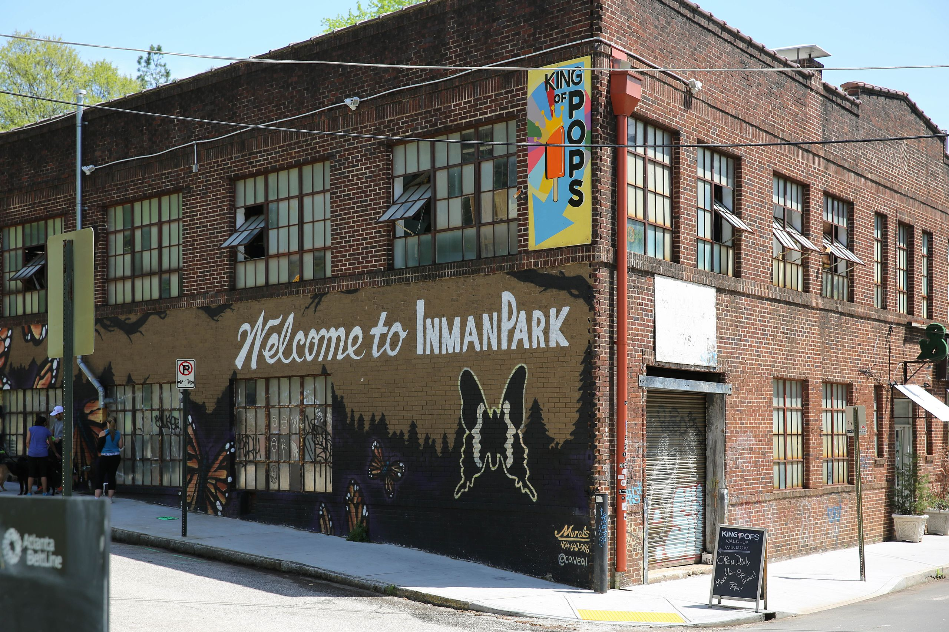
Conclusion and Discussion
After quantifying transport and demographic factors, and using transport and urban planning factors as restrictions, we have determined that Midtown and Inman Park are the best locations for a metal music venue business.
In more detail, Midtown has a more established music venue business and is more competitive. It will be more familiar to metalheads, but it is also a high-risk, high-reward type of venture.
Inman Park has higher potential with fewer existing music venues and suitable conditions for this business. Suggested location for music venue will be Edgewood Avenue, which has a restaurant street, however, the real estate price is also higher.

Slide 15
Reference
Shukla, Aditya. “The Social Psychology Of Heavy Metal & Rock Music: Research On Metalheads.” Cognition Today, September 19, 2022
Brown, Andy, Spracklen, Karl, Kahn-Harris, Keith, Scott, Niall. “Global Metal Music and Culture: Current Directions in Metal Studies.” Routledge, 2016
Psyllidis, A., Gao, S., Hu, Y., Kim, E. K., McKenzie, G., Purves, R., Yuan, M., & Andris, C. (2022). Points of Interest (POI): a commentary on the state of the art, challenges, and prospects for the future. Computational Urban Science, 2(20)
Prandi, C., Barricelli, B. R., Mirri, S., & Fogli, D. (2023). Accessible wayfinding and navigation: a systematic mapping study. Universal Access in the Information Society, 22, 185-212
Picture source:
P8: https://www.deviantart.com/nataliaakaczmarczyk/art/Majestatic-Metalheads-893413346
P8-2: https://finance.yahoo.com/news/watch-behaviour-analyst-serve-amusing-103054565.html?guccounter=1&guce_referrer=aHR0cHM6Ly93d3cuZ29vZ2xlLmNvbS8&guce_referrer_sig=AQAAADjXRPMtDjwVAduVO24TNFmF5-Q5qV5R7Q7PLe97yjNCDnfmnQBNLmLcglIAK52qJfKycyFAUQLhgz4LO_vksMEXqBxMnuij0TCzJkWJoUoESeHcfm3cYHgDHy9xuOqGbpBoffQAXnqgf5UuznO-gy58mnE2WS7WPqheNei7BsSl
P14: https://en.wikipedia.org/wiki/Inman_Park#Atlanta's_first_intown_neighborhood_to_gentrify

Slide 16

Thank you Open to comments and suggestions!

